Slide 1
Natural Language Processing
AI4ALL

Slide 2
What is “NLP”?
“Natural-language processing (NLP) is an area of computer science and artificial intelligence concerned with the interactions between computers and human (natural) languages, in particular how to program computers to fruitfully process large amounts of natural language data.”
- Wikipedia
https://en.wikipedia.org/wiki/Natural-language_processing

Slide 3
What is “NLP”?
“Natural-language processing (NLP) is an area of computer science and artificial intelligence concerned with the interactions between computers and human (natural) languages, in particular how to program computers to fruitfully process large amounts of natural language data.”
- Wikipedia
https://en.wikipedia.org/wiki/Natural-language_processing

Slide 4
What is “NLP”?
“Natural-language processing (NLP) is an area of computer science and artificial intelligence concerned with the interactions between computers and human (natural) languages, in particular how to program computers to fruitfully process large amounts of natural language data.”
- Wikipedia
https://en.wikipedia.org/wiki/Natural-language_processing

Slide 5
What is “NLP”?
“Natural-language processing (NLP) is an area of computer science and artificial intelligence concerned with the interactions between computers and human (natural) languages, in particular how to program computers to fruitfully process large amounts of natural language data.”
- Wikipedia
https://en.wikipedia.org/wiki/Natural-language_processing

Slide 6
What is “NLP”?
“Natural-language processing (NLP) is an area of computer science and artificial intelligence concerned with the interactions between computers and human (natural) languages, in particular how to program computers to fruitfully process large amounts of natural language data.”
- Wikipedia
https://en.wikipedia.org/wiki/Natural-language_processing

Slide 7
Why do we care?

Slide 8
“Analysts at Gartner (gated) estimate that upward of 80% of enterprise data today is unstructured.”
https://www.forbes.com/sites/forbestechcouncil/2017/06/05/the-big-unstructured-data-problem/#13919ec4493a

Slide 9
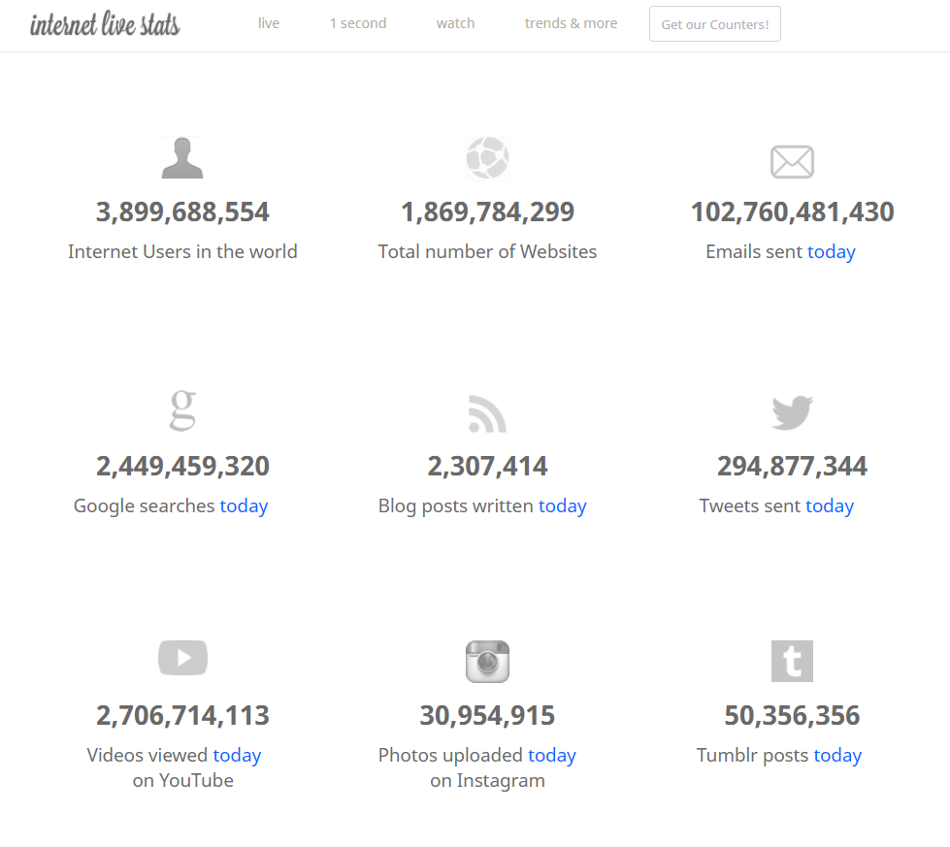
http://www.internetlivestats.com/

Slide 10
What can we work on?

Slide 11
What is “NLP”?
“Natural-language processing (NLP) is an area of computer science and artificial intelligence concerned with the interactions between computers and human (natural) languages, in particular how to program computers to fruitfully process large amounts of natural language data.
Challenges in natural-language processing frequently involve speech recognition, natural-language understanding, and natural-language generation.”
- Wikipedia
https://en.wikipedia.org/wiki/Natural-language_processing

Slide 12
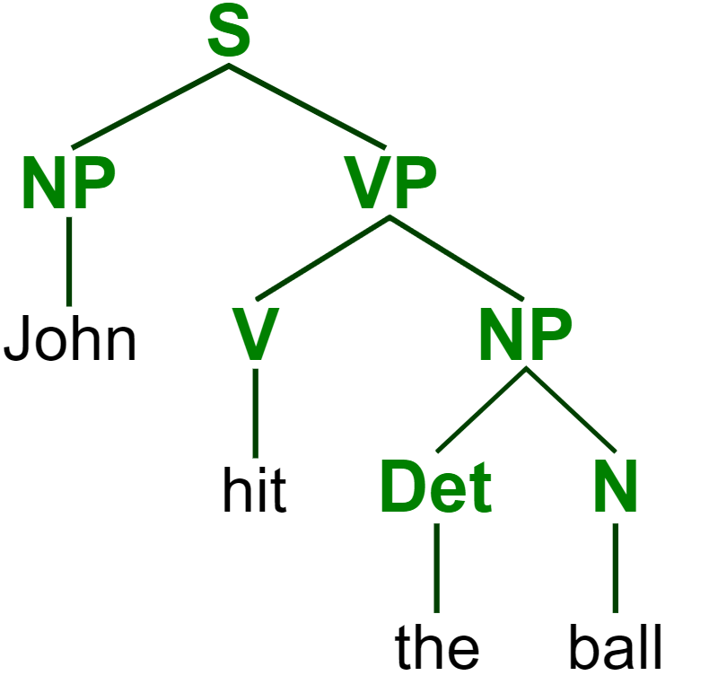
https://commons.wikimedia.org/wiki/File:ParseTree.svg
Notes:
Parse tree: sentence; noun phrase, verb phrase; verb, determiner, noun

Slide 13
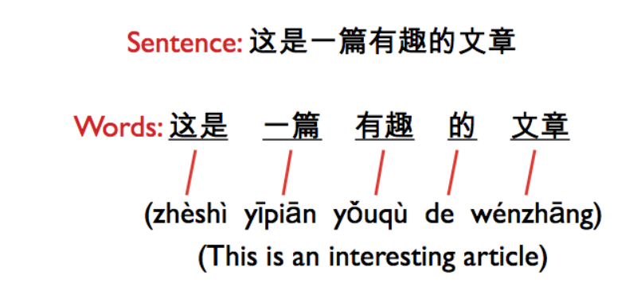
http://iconictranslation.com/2014/10/language-challenge-7-chinese/

Slide 14
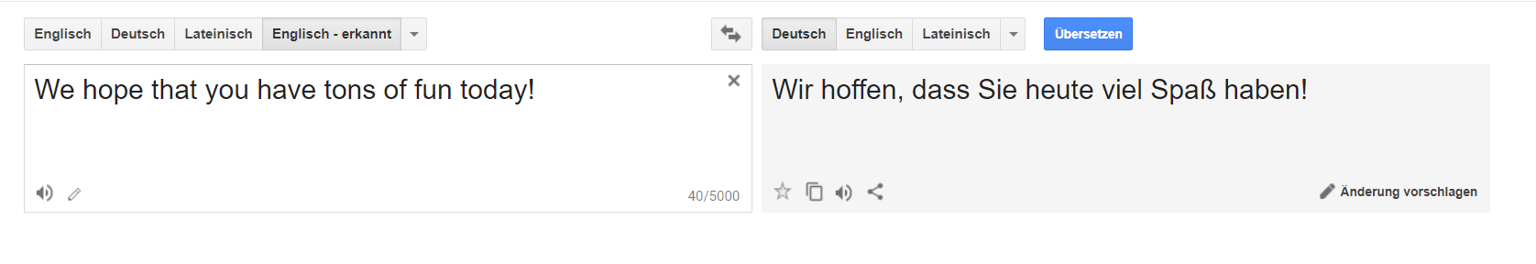
translate.google.com

Slide 15
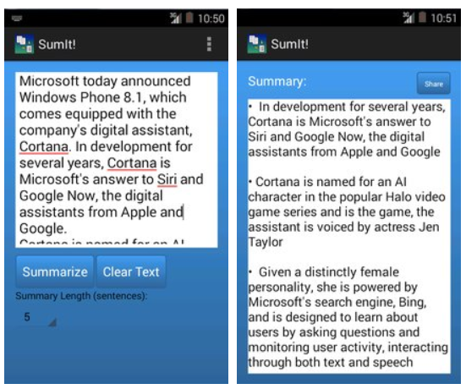
https://apkpure.com/sumit-text-summarization/com.karimo.sumit_final

Slide 16
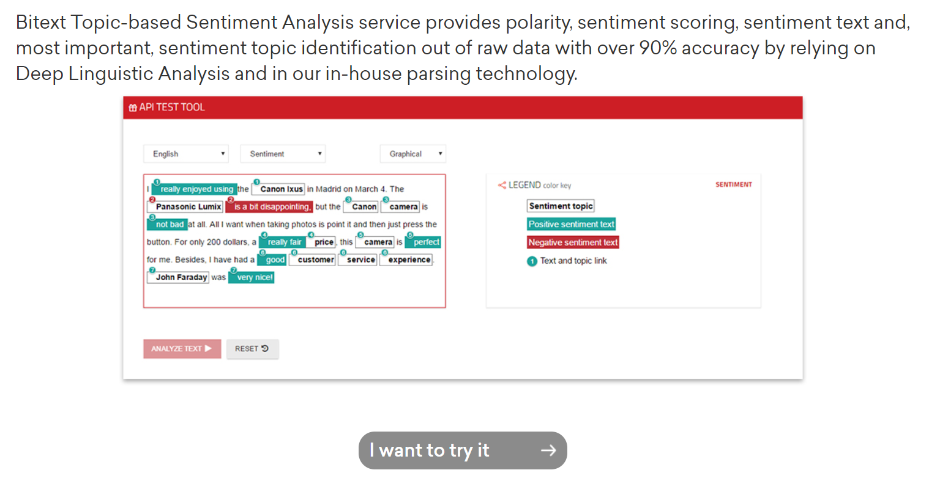
https://www.bitext.com/sentiment-analysis/

Slide 17
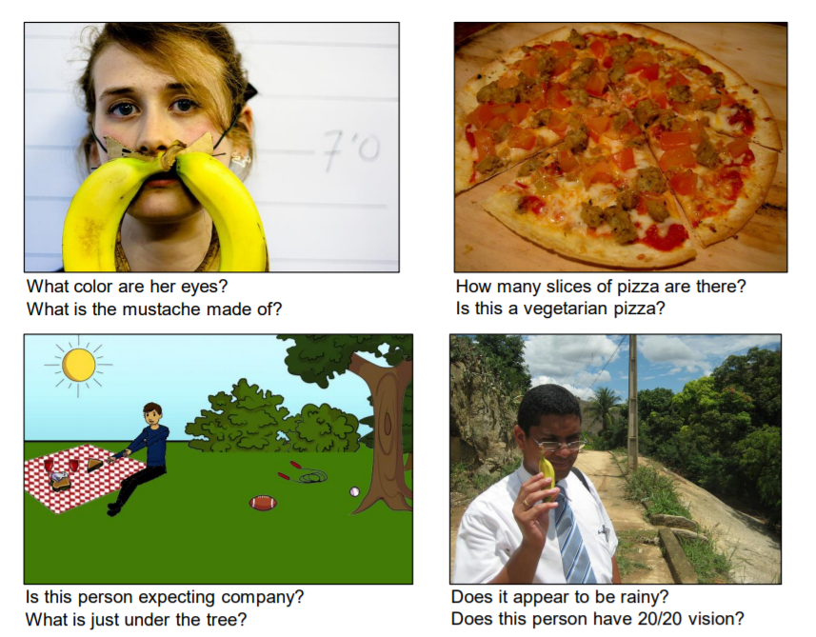
A. Agrawal et al., “VQA: Visual Question Answering,” arXiv:1505.00468 [cs], May 2015.

Slide 18

https://matlab1.com/support-vector-machine-speech-recognition/

Slide 19
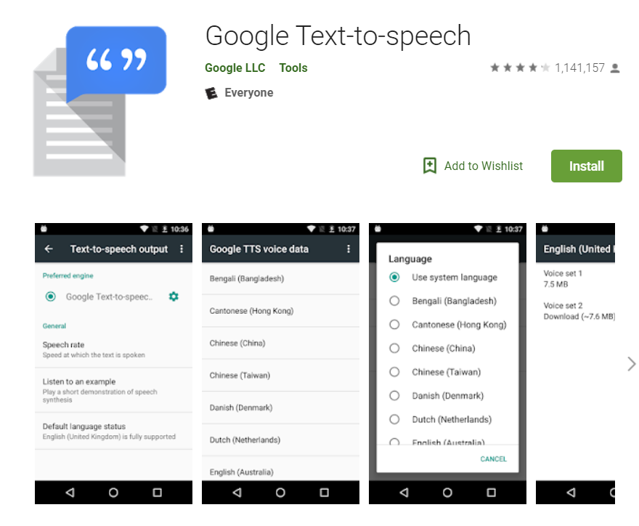
https://play.google.com/store/apps/details?id=com.google.android.tts&hl=en_US

Slide 20
What makes it difficult?

Slide 21
What is “NLP”?
“Natural-language processing (NLP) is an area of computer science and artificial intelligence concerned with the interactions between computers and human (natural) languages, in particular how to program computers to fruitfully process large amounts of natural language data.”
- Wikipedia
https://en.wikipedia.org/wiki/Natural-language_processing

Slide 22
translate.google.com

Slide 23

https://www.ecenglish.com/en/social/blog/ec-central/2015/11/23/vocab-review-homophones

Slide 24
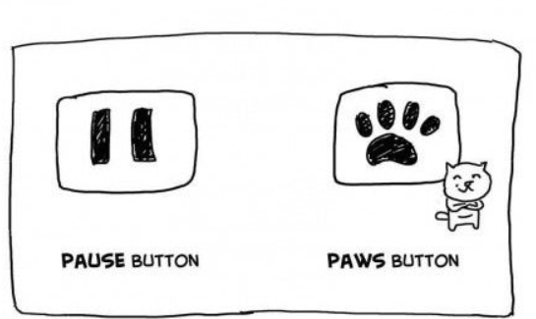
https://i.pinimg.com/originals/0a/92/15/0a921501fa2c6ad60f2e7cde0c8e90a4.jpg

Slide 25

https://www.creators.com/read/speed-bump/02/16/165650

Slide 26
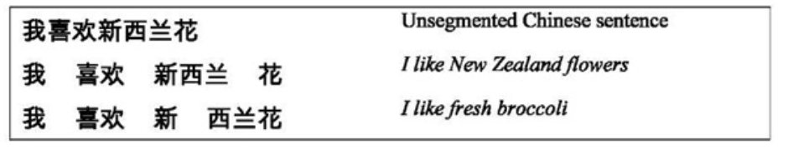
http://what-when-how.com/how-to-build-a-digital-library/word-segmentation-and-sorting-digital-library/
Notes:
Segmentation

Slide 27

http://onthesannyside.blogspot.com/2015/08/fun-with-dangling-modifiers.html

Slide 28

http://explosm.net/comics/1206

Slide 29

https://imgur.com/r/thesimpsons/1ZKxV5O
Notes:
Ambiguous sentences: https://www.teatime-mag.com/magazines/wp-content/themes/tt/print/teatime61/print.pdf

Slide 30
How does it work?
…and how can we make it work?

Slide 31
Human Learning
Statistical learning: learning how to understand and speak language by analyzing how others speak
Word frequencies, word order, recurring grammatical patterns
Segmentation: 8-month-old infants react differently to pseudowords than non-words after 2 minutes of exposure to nonsense speech
Examples:
“Powerful coffee”
“Strong rain”
“Profound sleep”
http://akenney.github.io/mind-cascade/language/

Slide 32
Natural Language Understanding
Natural Language Generation
Break speech down into letter / sound chunks
Compare to recorded phonemes and pick likeliest combinations
Thank back to Hangman
Garden path sentences
Get the important question words
Check the internet for response to question (or perform an action)
Form sentence around answer information using grammatical rules
Use speech to text!

Slide 33
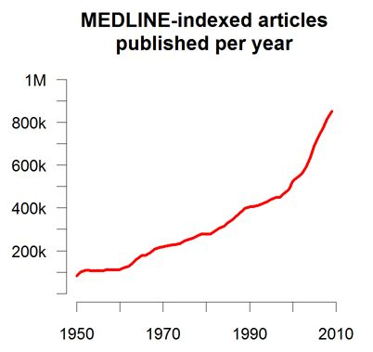

Medicine
More complete and accurate patient records – computer assisted coding

Slide 34
Medicine
More complete and accurate patient records – computer assisted coding
Efficiency gains: doctors can dictate their notes

Slide 35
Medicine
More complete and accurate patient records – computer assisted coding
Efficiency gains: doctors can dictate their notes
Clinical decision support: IBM Watson can learn from entirety of Medline literature; impossible for doctors to read even a fraction of this

Slide 36
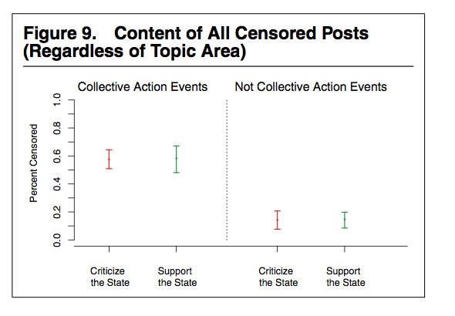
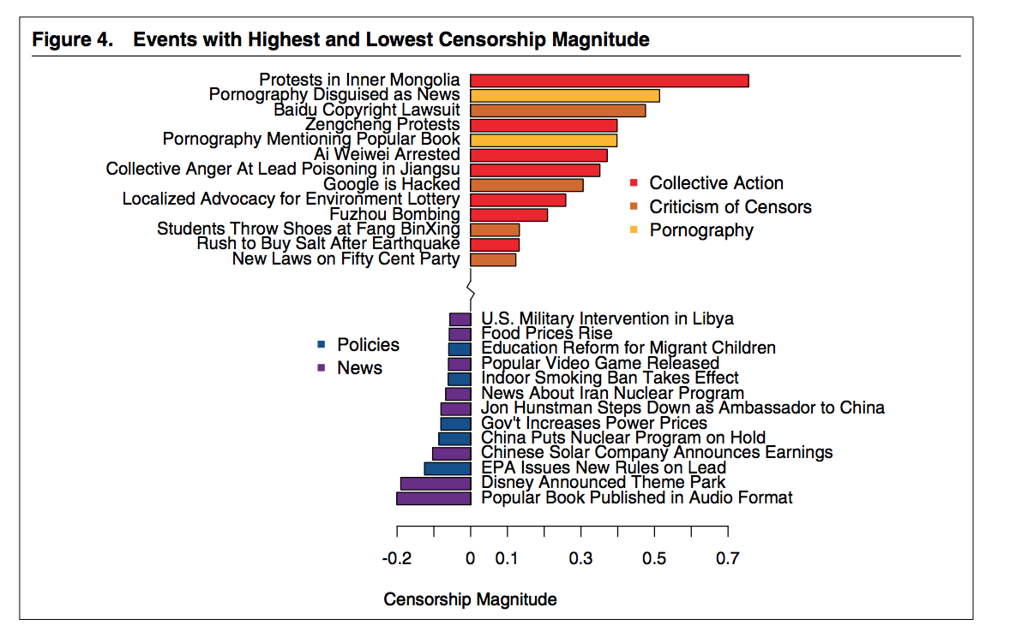
Censorship in China
King et al. 2013

Slide 37
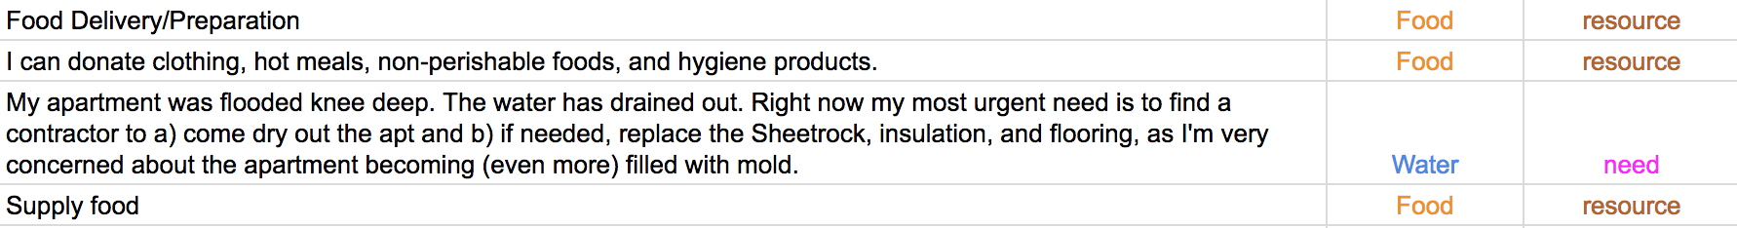
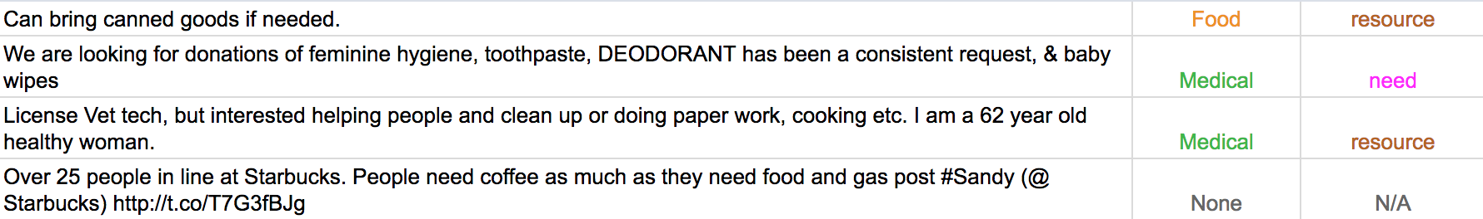
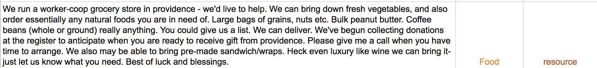
Disaster Relief and Resource Allocation - Twitter

Slide 38
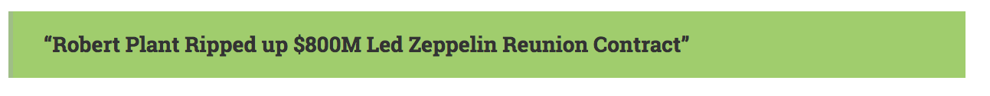
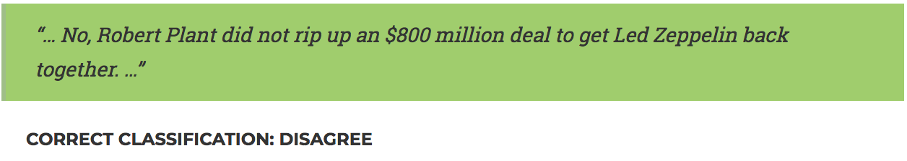
Fake News Challenge
Headline:
Claims:
Goal: train computer to recognize claims associated with headline as IN AGREEMENT, IN DISAGREEMENT, RELATED or UNRELATED

Slide 39
Fake News Challenge
Headline:
Claims:
Goal: train computer to recognize claims associated with headline as IN AGREEMENT, IN DISAGREEMENT, RELATED or UNRELATED

Slide 40
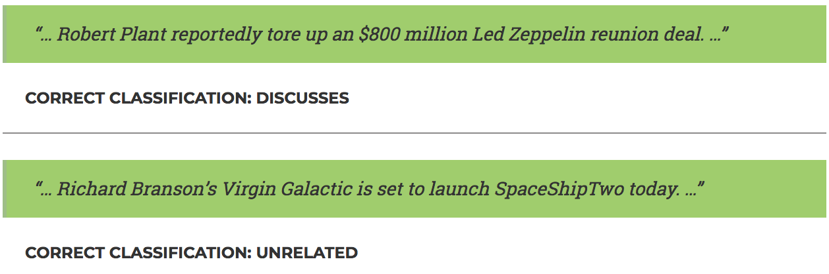
Fake News Challenge
Headline:
Claims:
Goal: train computer to recognize claims associated with headline as IN AGREEMENT, IN DISAGREEMENT, RELATED or UNRELATED

Slide 41
Fake News Challenge
Headline:
Claims:
Goal: train computer to recognize claims associated with headline as IN AGREEMENT, IN DISAGREEMENT, RELATED or UNRELATED

